Slide 1

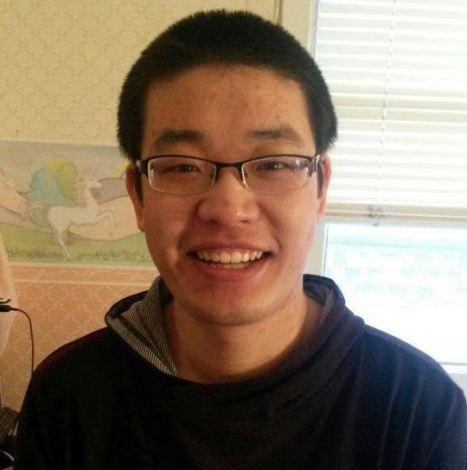
GAME 2005 - Game Physics
Name: Le Trung (Kyle)
ID: 101264698
Name: Shu Deng (Mike)
ID: 101260645
Assignment Info:
Assignment 2 - Projectile Motion, Circular Motion, Free body diagrams and Newton's Laws

Slide 2
GAME 2005 - Game Physics
Name: Shu Deng (Mike)
ID: 101260645
Assignment:
Lab 2

Slide 3

Assignment Videos (continued)
You must also include a short PowerPoint (or Google Slides) Slide Deck that includes a single slide to start your video
the first (and only) Slide of your Slide Deck must include a current image of you and your partner (no avatars allowed) that is displayed appropriately on the page. You must also include your Full Names, Student IDs, the Course Code, Course Name, and your Assignment information.
Each group member will be required to present
You will demonstrate your application’s functionality.
You will explain your application’s code.
Sound for your Video must at an appropriate level so that your voices may be clearly heard.
Your Screen and app UI should also be clearly visible.
Your Short Video should run no more than 5 minutes

